Slide 1
Pocket Circuits TA Project Architecture
Addison Ogonoski, Evan Gonzales, Emma Howard, Jessica Seto, Swathi Jaisankar

Slide 2
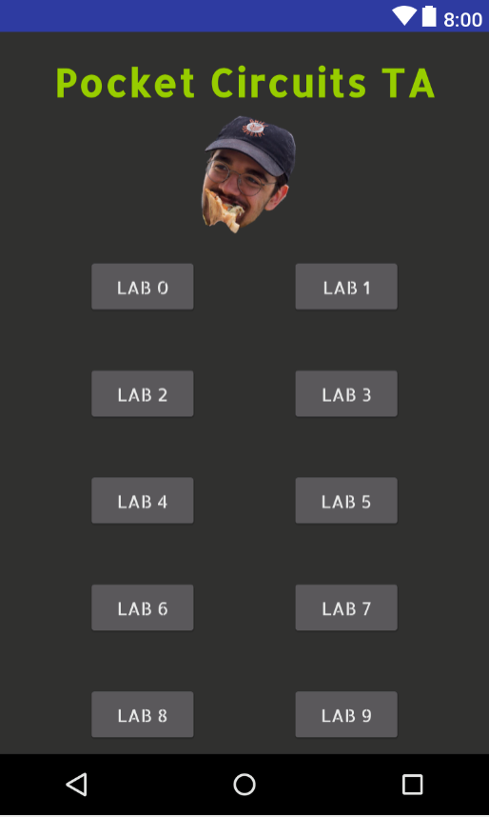
Main Page
The main page consists of 10 buttons that corresponds with Lab 0-9. Each activity holds relevant tools for each lab, such as calculators or diagrams.

Slide 3
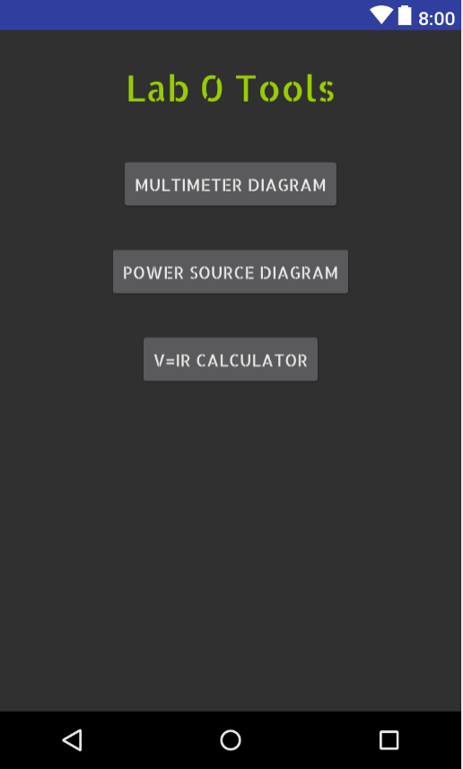
Lab 0: HOMEPAGE
Lab 0 button from the main page clicks into the Lab 0 activity. Lab 0 activity consists of three buttons that click into three separate activities: Multimeter Diagram, Power Source Diagram, and V=IR Calculator.

Slide 4
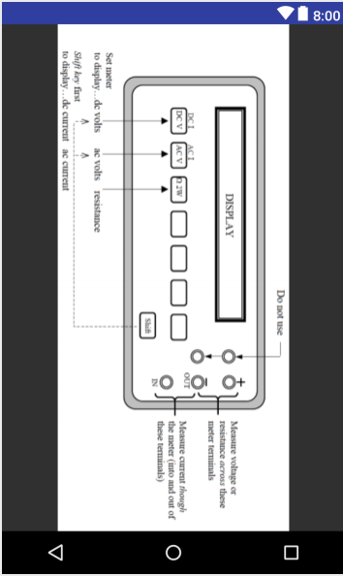
Lab 0: Multimeter Diagram
The Multimeter Diagram button clicks into an activity that displays a diagram of a multimeter with port explanations. This diagram is specific to BU equipment.

Slide 5
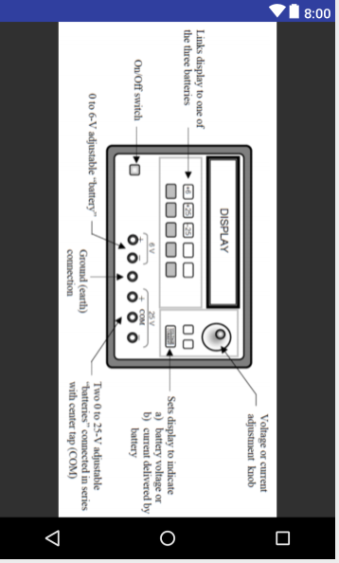
Lab 0: Power Source Diagram
The Power Source Diagram button clicks into an activity that displays a diagram of the power source with port explanations. This diagram is specific to BU equipment.

Slide 6
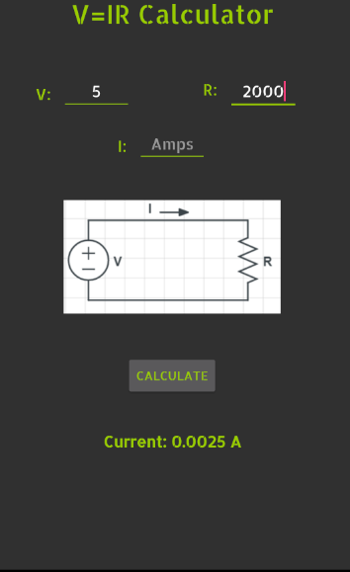
Lab 0: V=IR Calculator
The V=IR calculator accepts two inputs, then calculates and displays the remaining value. Two of the three user inputs must be filled to calculate the third value. Once the calculate button is pressed, the answer will display under the calculate button. There is also a circuit diagram as reference. This diagram is original.

Slide 7
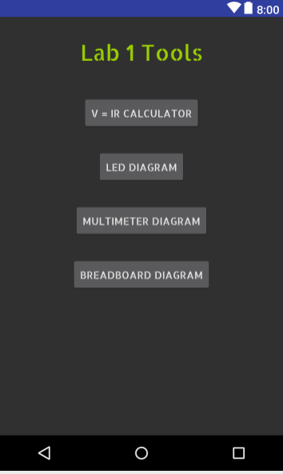
Lab 1: Homepage
Lab 1 button from the main activity opens the Lab 1 activity. The Lab 1 activity consists of four buttons that open four activities: V=IR Calculator, LED Diagram, Multimeter Diagram, and Breadboard Diagram.

Slide 8
Lab 1: V=IR Calculator
The V=IR Calculator button opens the V=IR Calculator activity. This activity takes two inputs and calculates the third. Two of the three user inputs must be filled to calculate the third value. Once the calculate button is pressed, the answer will display below the Calculate button. There is also a circuit diagram as reference.

Slide 9
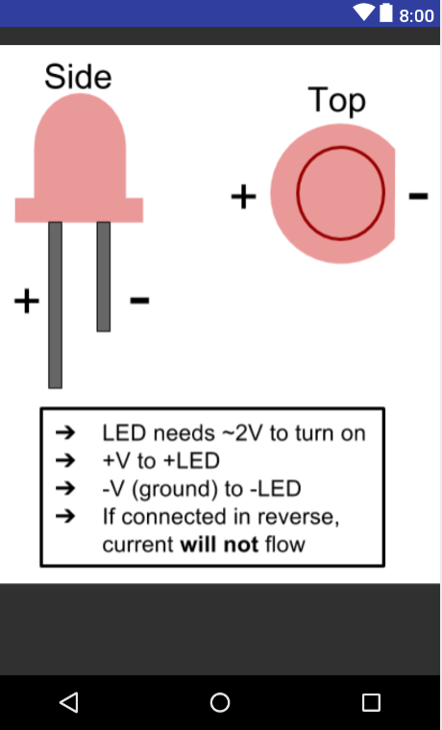
Lab 1: LED Diagram
The LED Diagram button clicks into an activity that displays an original LED Diagram. This diagram explains simple LED concepts. This diagram is original.

Slide 10
Lab 1: Multimeter Diagram
The Multimeter Diagram button clicks into an activity that displays a diagram of a multimeter with port explanations.

Slide 11
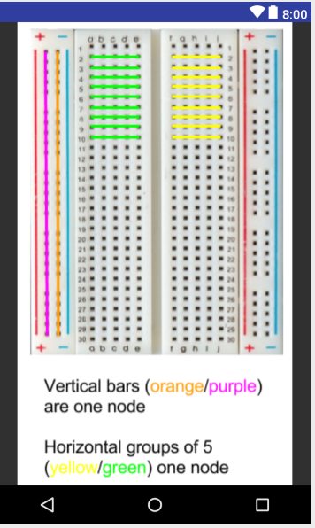
Lab 1: Breadboard Diagram
The Breadboard Diagram clicks into an activity that displays an original breadboard diagram. This diagram shows how ports are connected vertically and horizontally.

Slide 12
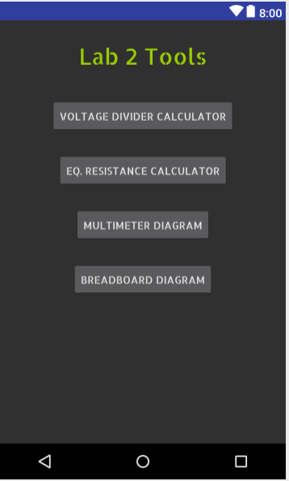
Lab 2: Homepage
Lab 2 button from the main page clicks into the Lab 2 activity. The Lab 2 activity consists of four buttons that click into four separate activities: Voltage Divider Calculator, Equivalent Resistance Calculator, Multimeter Diagram, and Breadboard Diagram.

Slide 13
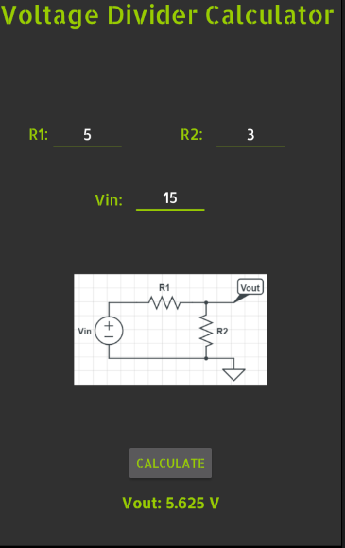
Lab 2: Voltage Divider Calculator
The Voltage Divider Calculator accepts three inputs and calculates the third. All three user inputs must be filled to calculate the Vout value. Once the calculate button is pressed, the answer will display below the Calculate button. There is also an original circuit diagram as reference.

Slide 14
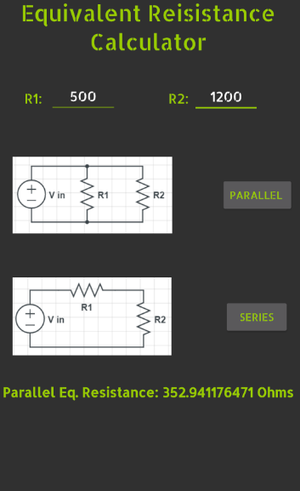
Lab 2: EQ. Resistance Calculator
The Equivalent Resistance Calculator accepts two inputs and calculates the equivalent resistance for parallel or series arrangements. Both user inputs must be filled to calculate the equivalent resistance value. Once the parallel or series button is pressed, the answer will display below. There are also circuit diagrams as reference.

Slide 15
Lab 2: Multimeter Diagram
The Multimeter Diagram button clicks into an activity that displays a diagram of a multimeter with port explanations.

Slide 16
Lab 2: Breadboard Diagram
The Breadboard Diagram button clicks into an activity that displays an original breadboard diagram. This diagram shows how ports are connected vertically and horizontally.

Slide 17
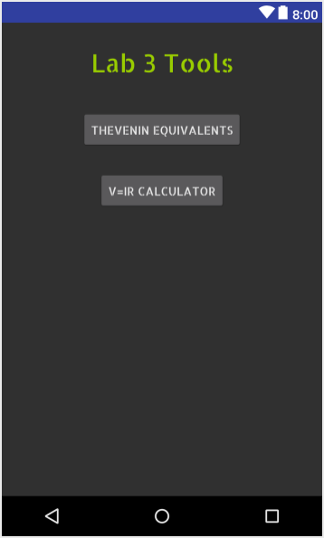
Lab 3: Homepage
Lab 3 button from the main page clicks into the Lab 3 activity. The Lab 3 activity consists of two buttons that click into two separate activities: Thevenin Equivalents and V=IR Calculator.

Slide 18
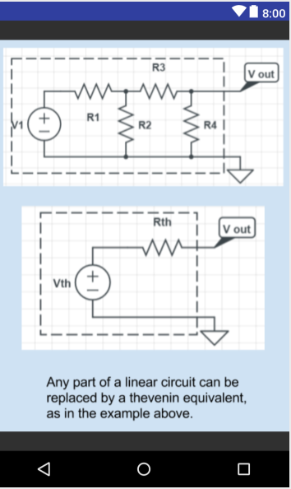
Lab 3: Thevenin Equivalents
The Thevenin Equivalents button opens to an activity that displays two original diagrams that explain the Thevenin theorem. This diagram is original.

Slide 19
Lab 3: V=ir calculator
The V=IR Calculator clicks into the V=IR Calculator activity. This activity takes two inputs and calculates the third. Two of the three user inputs must be filled to calculate the third value. Once the calculate button is pressed, the answer will display below the Calculate button. There is also a circuit diagram as reference.

Slide 20
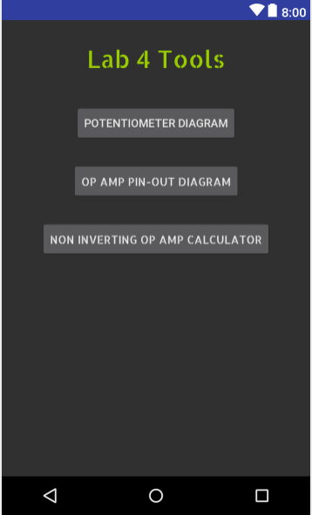
Lab 4: Homepage
Lab 4 button from the main page opens the Lab 4 activity. The lab 4 activity consists of three buttons that click into three separate folders: Potentiometer Diagram, Op Amp Pin Out Diagram, and Non Inverting Op Amp Calculator.

Slide 21
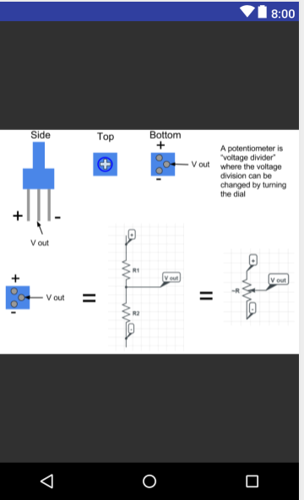
Lab 4: Potentiometer Diagram
The Potentiometer button opens an activity that displays a picture of original diagrams that explains the purpose and pins of a potentiometer.

Slide 22
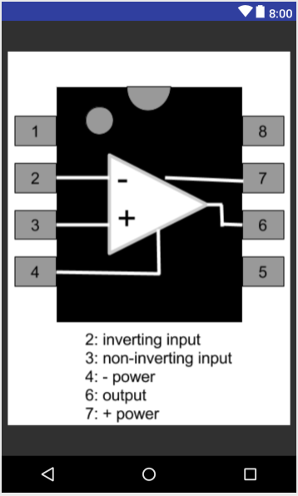
Lab 4: OP AMP Pin Out Diagram
The Op Amp Pin Out button opens an activity that displays an original diagram with labelled op amp pins.

Slide 23
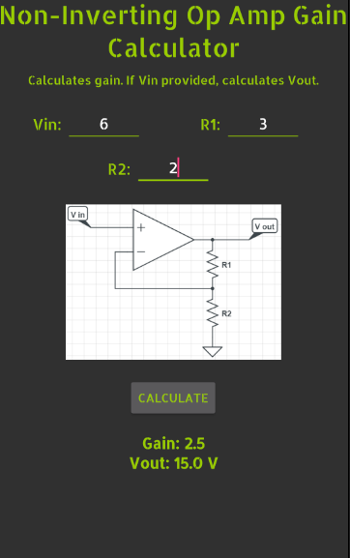
Lab 4: Non Inverting Op Amp Calculator
The Non-Inverting Op Amp Gain Calculator accepts three inputs and calculates the Vout and gain. If Vin is not given, then only gain is calculated. Once the calculate button is pressed, the answer will display below the Calculate button. There is also a circuit diagram as reference.

Slide 24
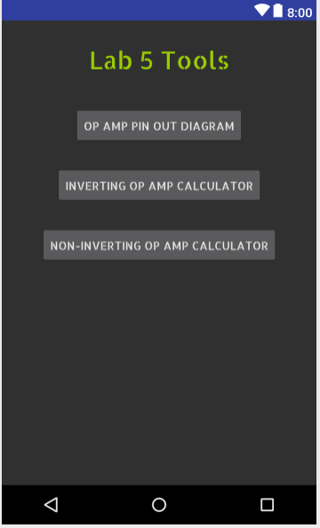
Lab 5: Homepage
Lab 5 button from the main page opens the Lab 5 activity. The Lab 5 activity consists of three buttons that open three activities: Op Amp Pin Out Diagram, Inverting Op Amp Calculator and Non Inverting Op Amp Calculator.

Slide 25
Lab 5: OP AMP Pin Out Diagram
The Op Amp Pin Out button opens to an original diagram that shows the different pins of the op amp.

Slide 26
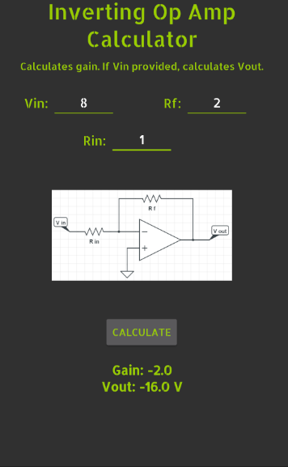
Lab 5: Inverting Op Amp Calculator
The Inverting Op Amp Gain Calculator accepts three inputs and calculates the Vout and gain. If Vin is not given, then gain is calculated. Once the calculate button is pressed, the answer will display below the Calculate button. There is also a circuit diagram as reference.

Slide 27
Lab 5: Non Inverting Op Amp Calculator
The Non-Inverting Op Amp Gain Calculator accepts three inputs and calculates the Vout and gain. If Vin is not given, then gain is calculated. Once the calculate button is hit, the answer will display below the Calculate button. There is also a circuit diagram as reference.

Slide 28
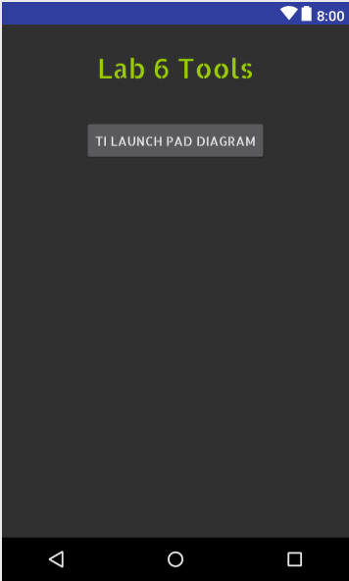
Lab 6: Homepage
Lab 6 button from the main activity clicks into the Lab 6 activity. The Lab 6 homepage contains one button that opens another activity: TI Launch Pad Diagram.

Slide 29
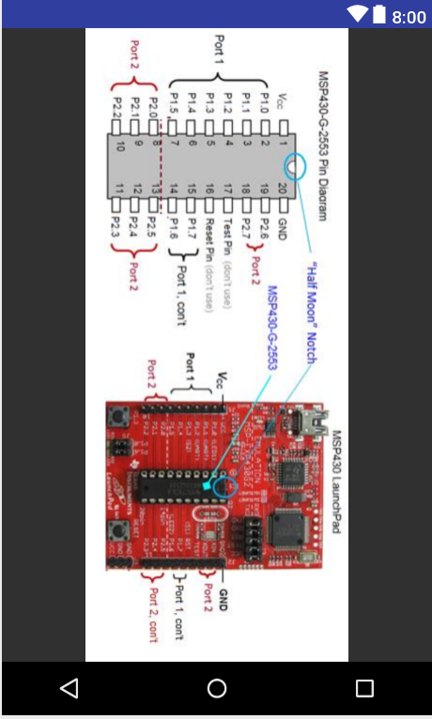
Lab 6: TI Launch Pad Diagram
The TI Launch Pad Diagram activity displays a diagram that shows the different pins of the TI Launch Pad.

Slide 30
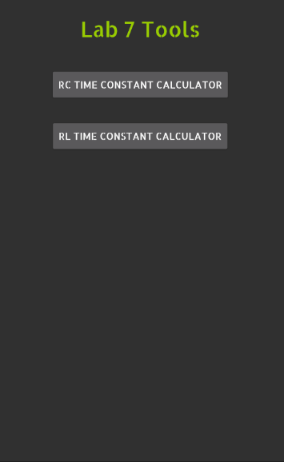
Lab 7: Homepage
Lab 7 button from the main activity clicks into the Lab 7 activity. The Lab 7 homepage consists of two buttons that open two activities: RC Time Constant Calculator and RL Time Constant Calculator.

Slide 31
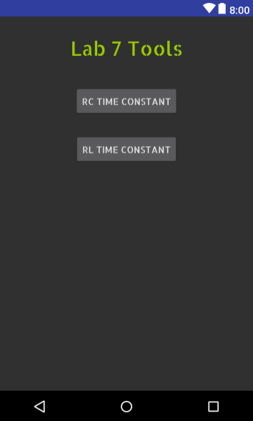
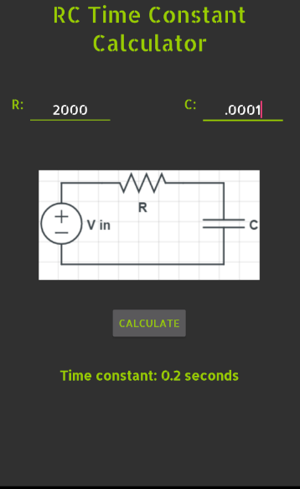
Lab 7: RC Time Constant Calculator
The RC Time Constant Calculator accepts two inputs and calculates the RC time constant. Once the calculate button is pressed, the answer will display below the Calculate button. There is also a circuit diagram as reference.

Slide 32
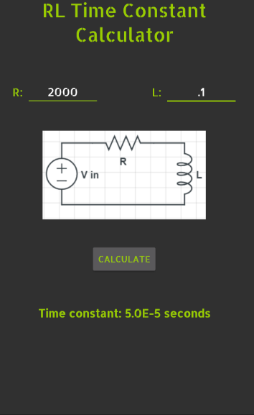
Lab 7: Rl Time Constant Calculator
The RL Time Constant Calculator accepts two inputs and calculates the RL time constant. Once the calculate button is pressed, the answer will display below the Calculate button. There is also a circuit diagram as reference.

Slide 33
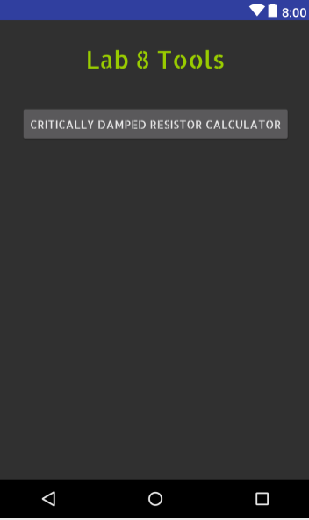
Lab 8: Homepage
Lab 8 button from the main activity clicks into the Lab 8 activity. The Lab 8 activity contains one button that opens another activity: Critically Damped Resistor Calculator.

Slide 34
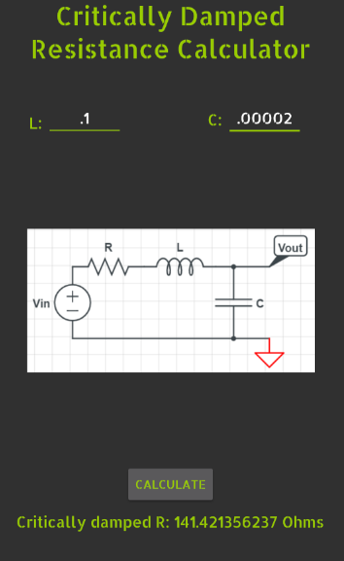
Lab 8: Critically Damped Resistor Calculator
The Critically Damped Resistance Calculator accepts two inputs and calculates the critically damped resistance. Once the calculate button is pressed, the answer will display below the Calculate button. There is also a circuit diagram as reference.

Slide 35
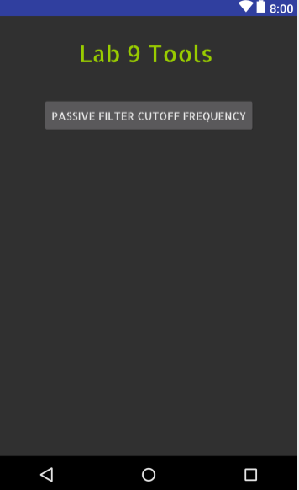
Lab 9: Homepage
Lab 9 button from the main activity clicks into the Lab 9 activity. The Lab 9 activity contains one button that opens another activity: Passive Filter Cutoff Frequency.

Slide 36
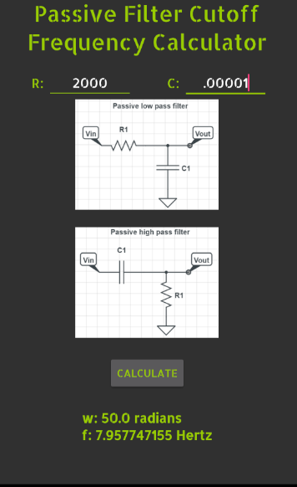
Lab 9:Passive Filter Cutoff Frequency
The Passive Filter Cutoff Frequency Calculator takes two inputs. When the Calculate button is pressed, both the frequency and angular frequency are displayed. There are original diagrams of low-pass and high pass filters for reference.
Notes:
REPLACE SECOND IMAGE

Slide 37
Included tools
Calculators:
V=IR
Voltage Divider
Eq resistance
Noninverting Op Amp
Inverting Op Amp
RC time constant
RL time constant
Critically Damped Resistance
Cutoff Frequency
Diagrams:
Multimeter
Power Source
LED
Breadboard
Thevenin Equivalents
Potentiometer
Op Amp Pins
TI Launchpad

Slide 38
How the code Works
Calculators:
There are text boxes set up to accept user inputs and store them into variables. These text inputs accept specific types depending on their nature (negative, decimal, etc.) Then after checking that the proper amount of inputs has been achieved, and that these inputs are valid, the calculations run when the “Calculate” button is pressed. After the answer is calculated, it is stored into another variable. That variable is then printed as text at the bottom of the page.
Inputs can be in decimal or negative forms if logical. Resistance, for example, cannot be negative. Outputs are displayed in scientific notation if the value is sufficiently large or small.

Slide 39
How the code Works
Error checking:
For each calculator, we implemented defensive error checks. If not enough values are entered into the fields, pressing “Calculate” will output a message saying that not enough fields were filled out. A similar message is displayed if too many fields are filled out, or those input values are invalid (eg. If a calculator cannot divide by zero). We also have logical error checking. For example in the V=IR calculator, inputting a positive voltage and negative current outputs “Voltage and current must match sign.”

Slide 40
How the code Works
Diagram Activities:
The diagrams are straight-forward and meant to be understood easily. Most were custom made.
The image is locked in portrait mode so that when the phone is turned to view the image, the orientation does not change to landscape.
8 individual activities were created with diagrams only.

